Slide 1
Introduction to Computing for Data Analysis
Clustering via k-means
Rachel Wiseley
Teaching Assistant
K-means Defined
Notes:
When you have a data set where each data point has a label, then using supervised learning, such as logistic regression can be used. However, many times, data does not have labels but we will want to work to discover possible labels (or other hidden patterns or structures). Thus, we will use unsupervised learning.

Slide 2
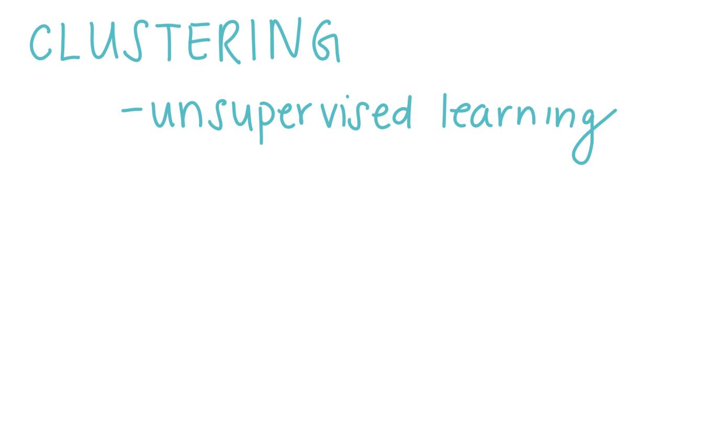
Notes:
Clustering is one form of unsupervised learning methods.

Slide 3
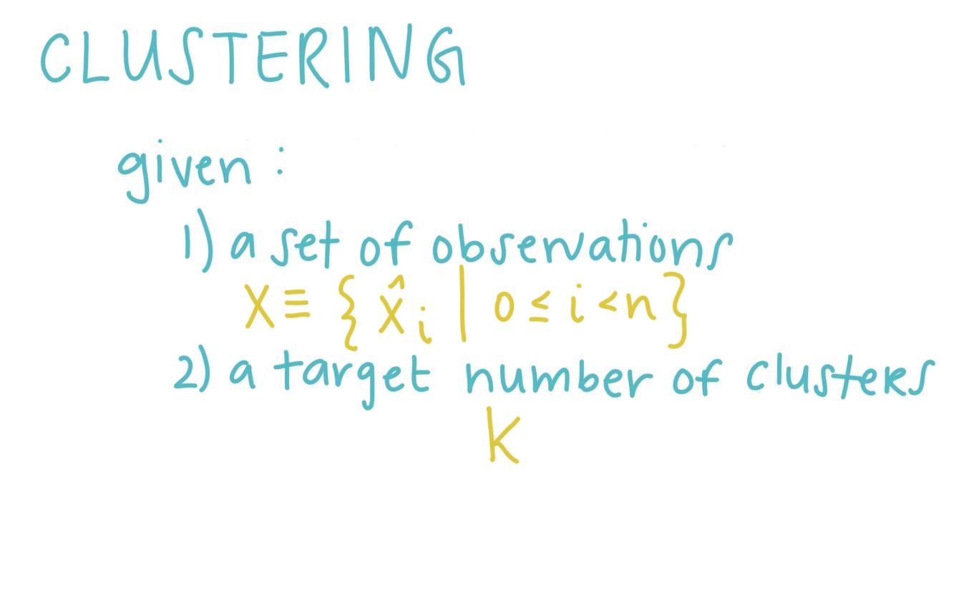
Notes:
Suppose you are given a data set, X, which contains a set of observations. Furthermore, you have a target number of clusters in mind, say k.

Slide 4
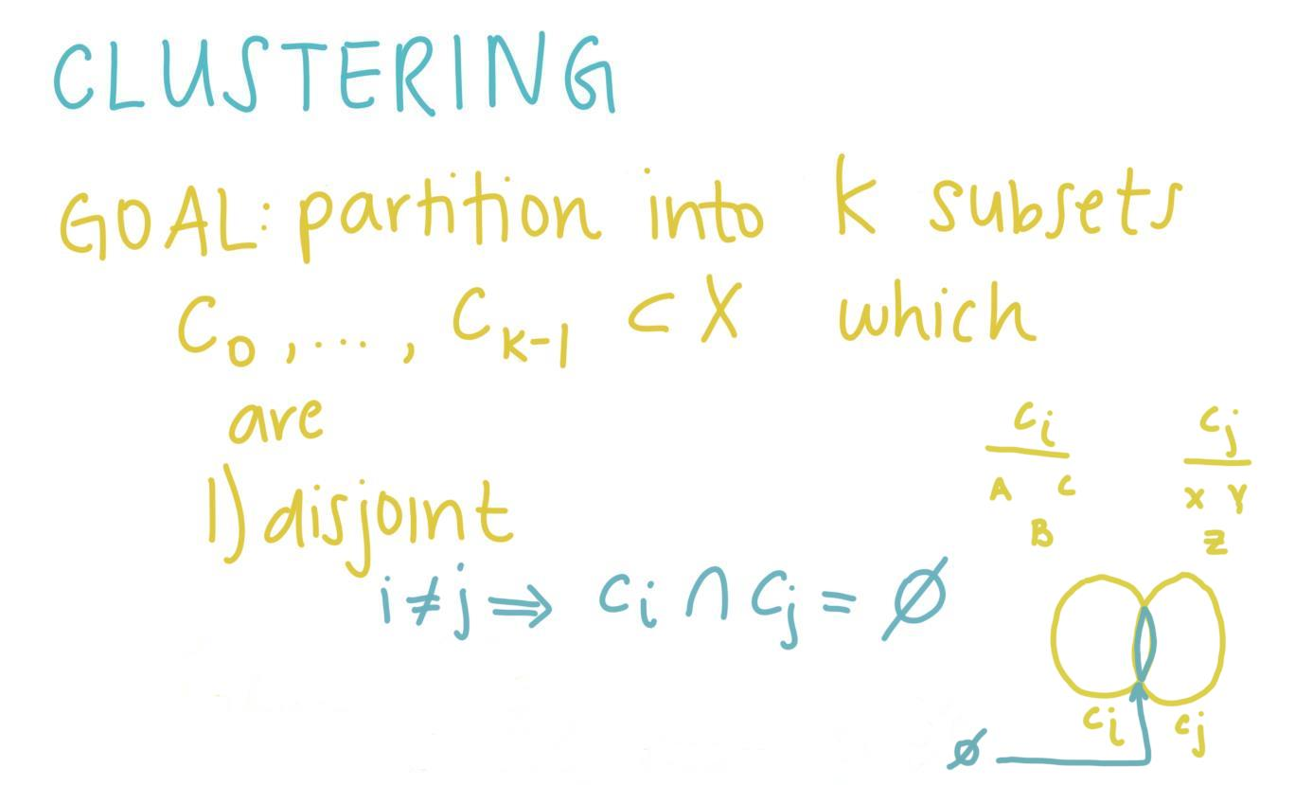
Notes:
The goal of clustering is to partition the data points in X into k subsets. We will label the subsets. the subsets are disjoint (meaning the intersection of any two subsets is the empty set). Thus for example if X contained the points A,b,c,x,y, z such that a,b,c belonged to subset Ci while x,y,z belonged to Cj, when the two subsets intersect, there are no data points in both subsets.

Slide 5
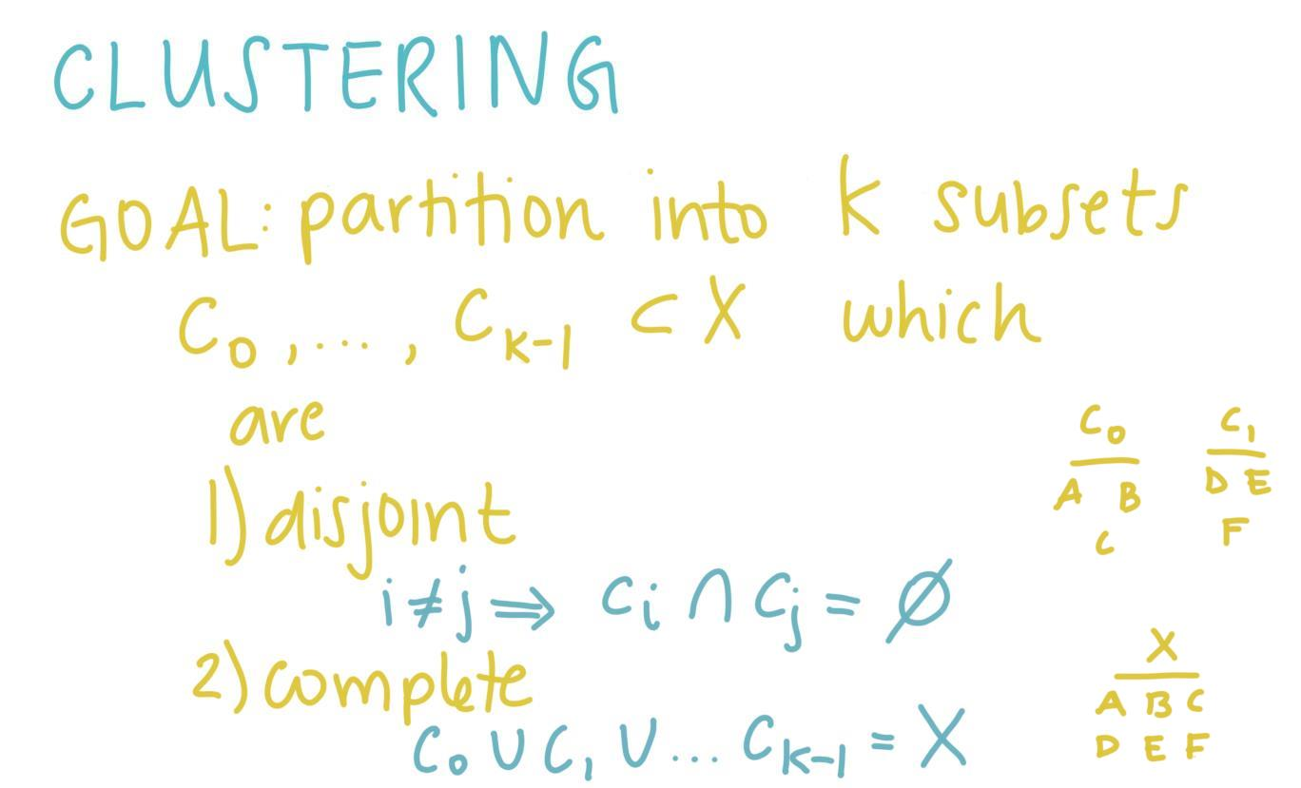
Notes:
The second goal of clustering is that the subsets are complete. Thus if X contains 6 data points, A-F then all points should belong to a subset. Thus we see that A,B,C belong to Co while C1 contains D,E,and F.

Slide 6
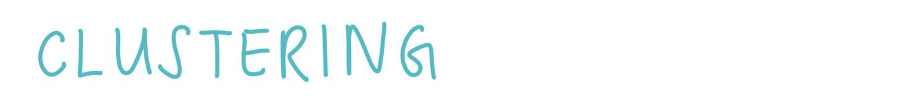
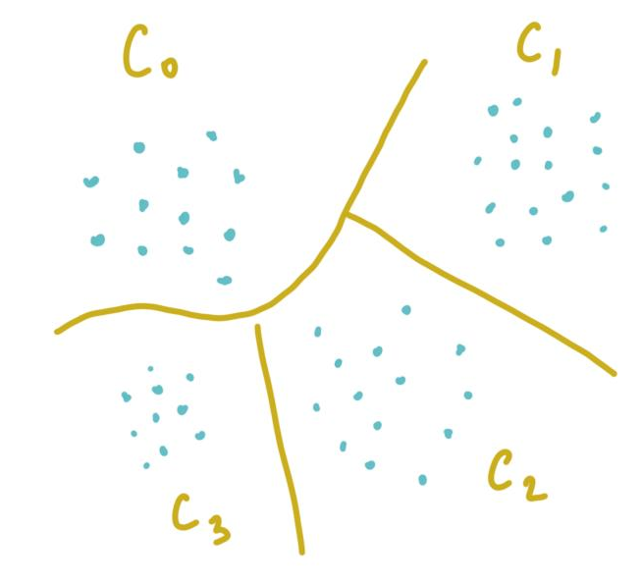


Notes:
Each cluster should reflect some sensible grouping. A and B represent 2 ways the same data set could be grouped together. Perhaps A is more logical in how it clusters the data in comparison to B.
Now, we just need to specify what constitutes such a grouping.

Slide 7
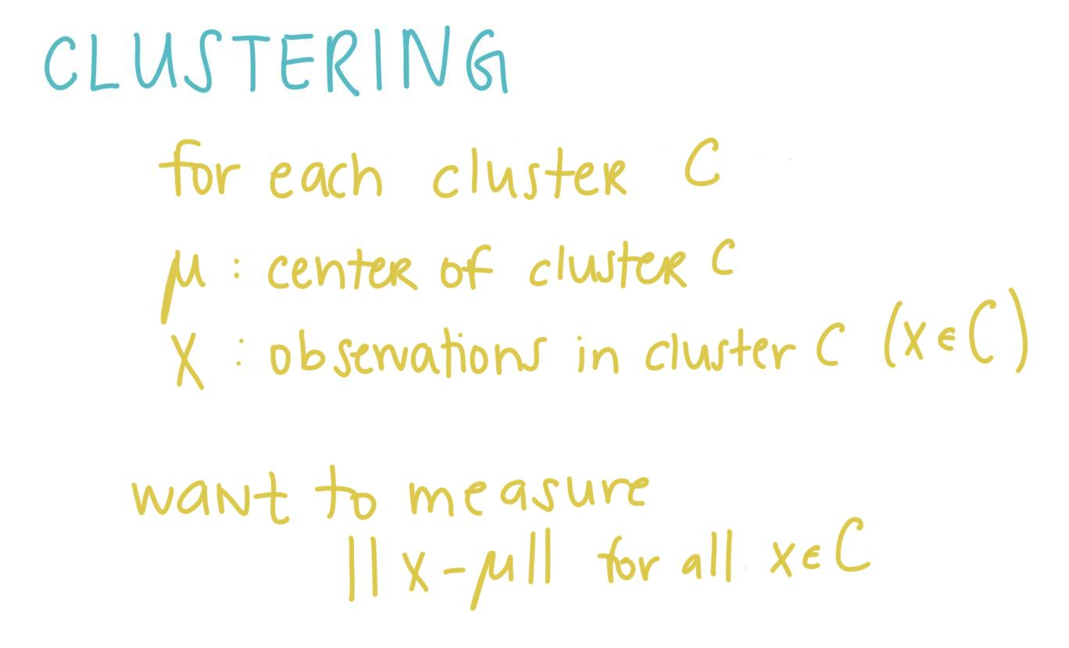
Notes:
We will now examine one method for measuring the quality of the set of clusters. First, for each cluster, C, we consider its center mu and measure the distance of each observation x which is in C from the center.

Slide 8
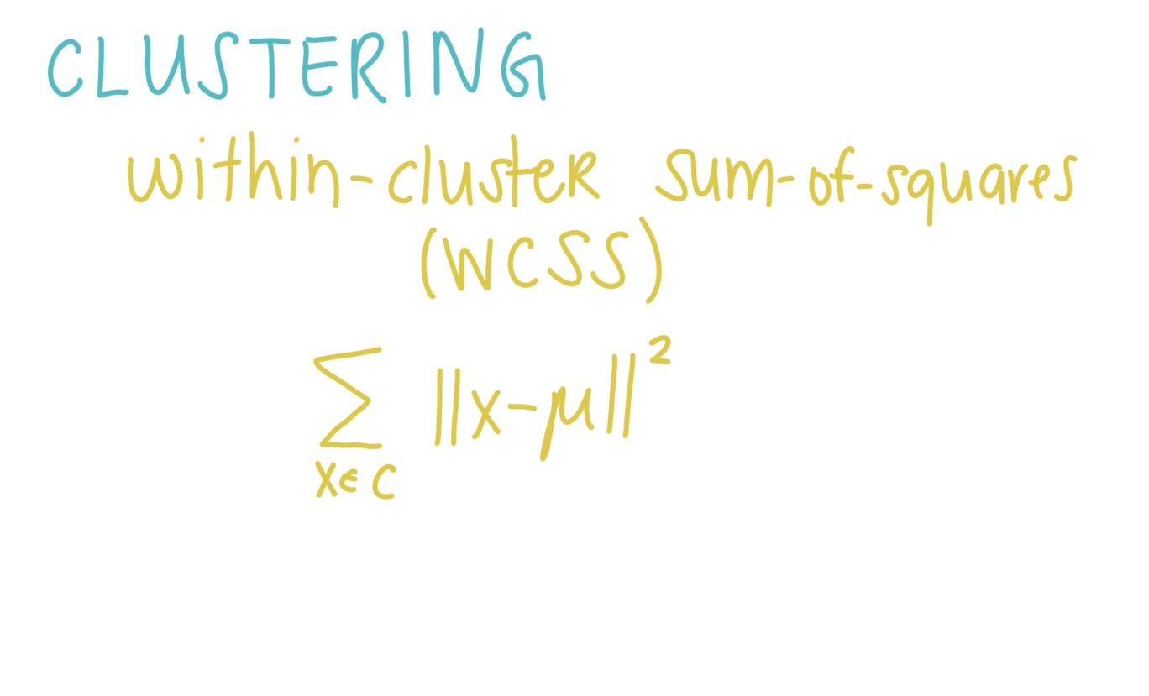
Notes:
Adding up all the distances for the points in the cluster is called the within-cluster sum-of-squares (WCSS).

Slide 9
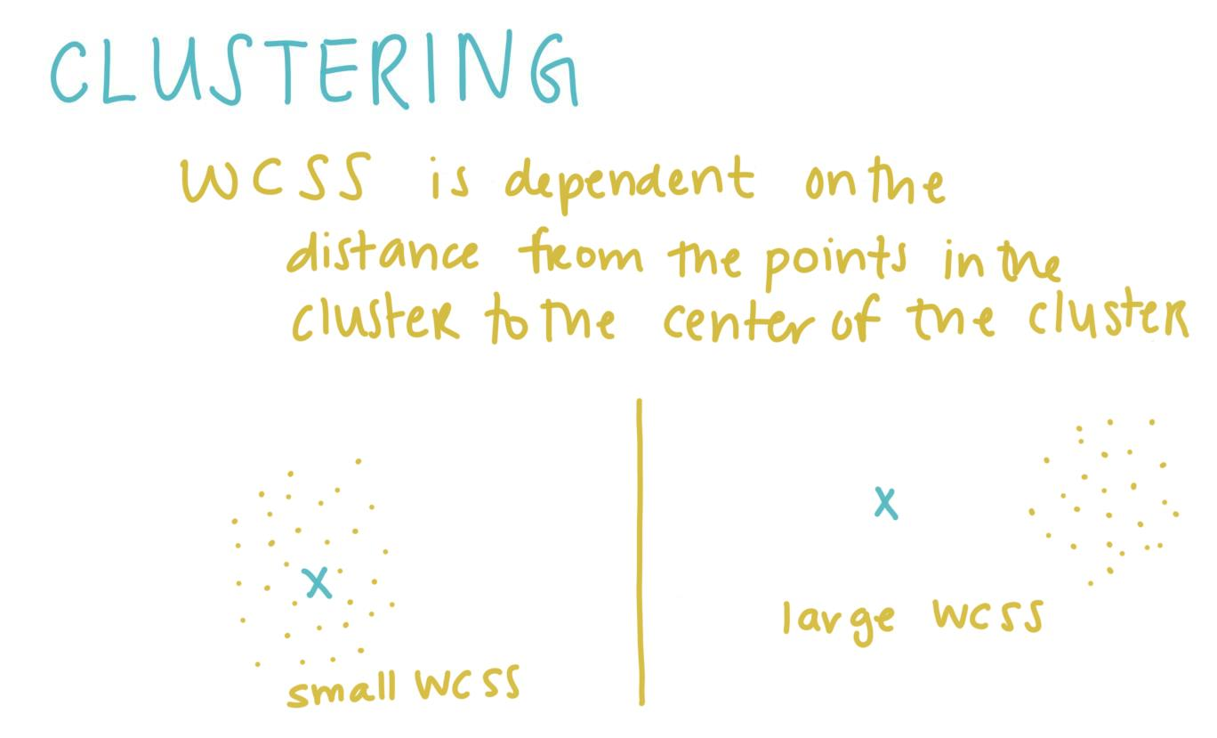
Notes:
Since WCSS is calculated from the distance between the points in the cluster and the center of cluster, the placement of the centroid highly affects the WCSS value. If the centroid is close to the points in the cluster, then the WCSS is small; while if the centroid is far from the points, the WCSS increases.

Slide 10
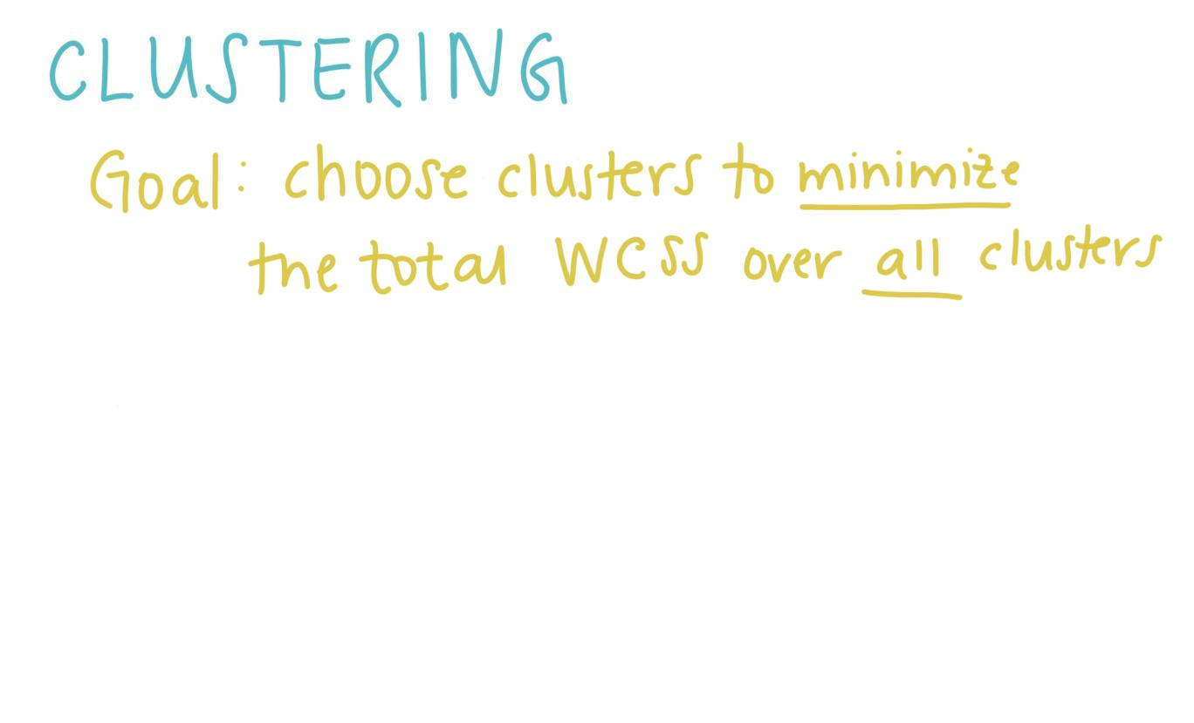
Notes:
Then we want to set our goal for our algorithm to choose clusters that minimize the total WCSS over all clusters.

Slide 11
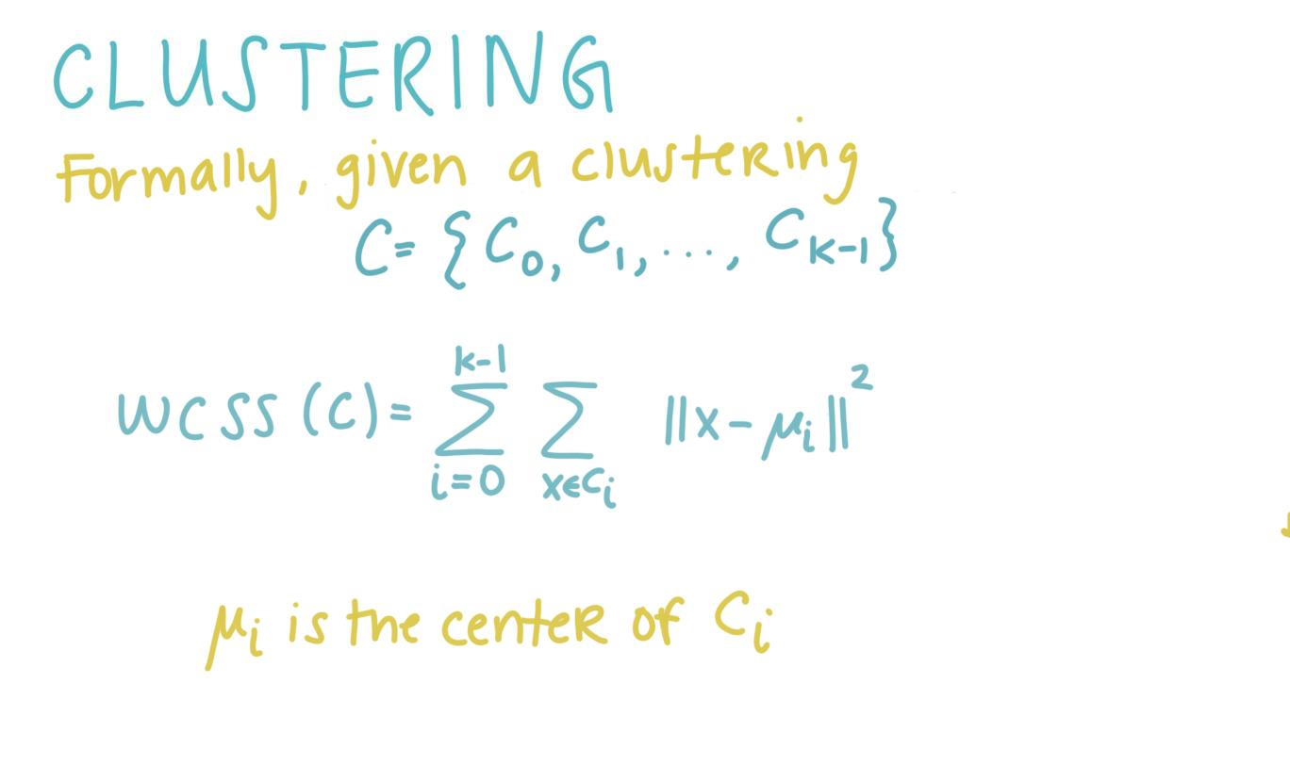
Notes:
More formally, given a clustering C which contains all the clusters for the data set, the WCSS for C is found by adding up the WCSS for each cluster’s observations. Thus we find the WCSS for each individual cluster and then add all the individual cluster’s WCSS together.

Slide 12
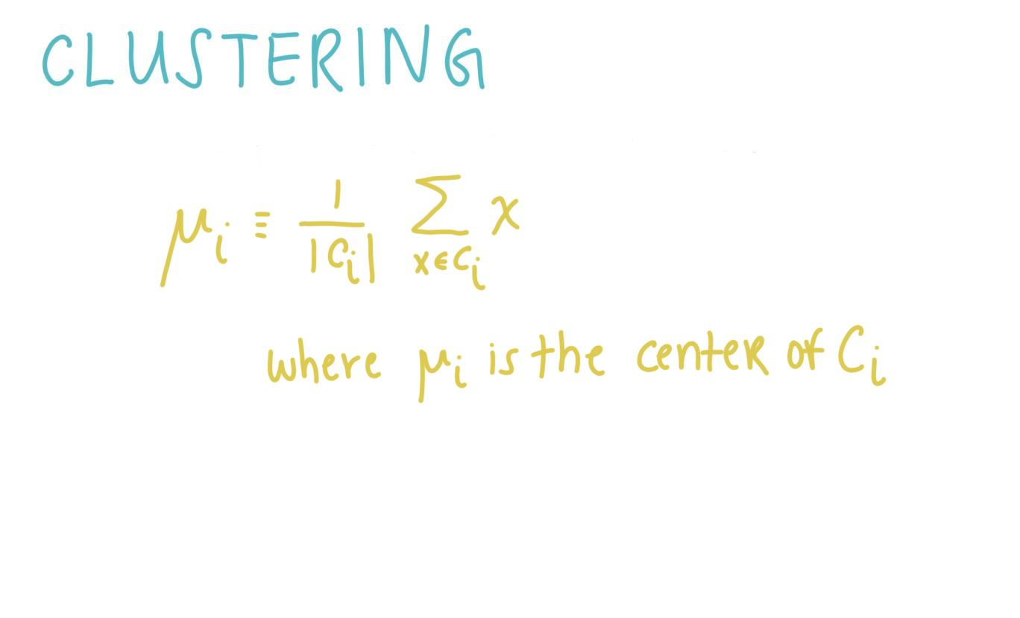
Notes:
But how do we find the mu? The center for each cluster is simply the mean of all the points in the cluster.

Slide 13
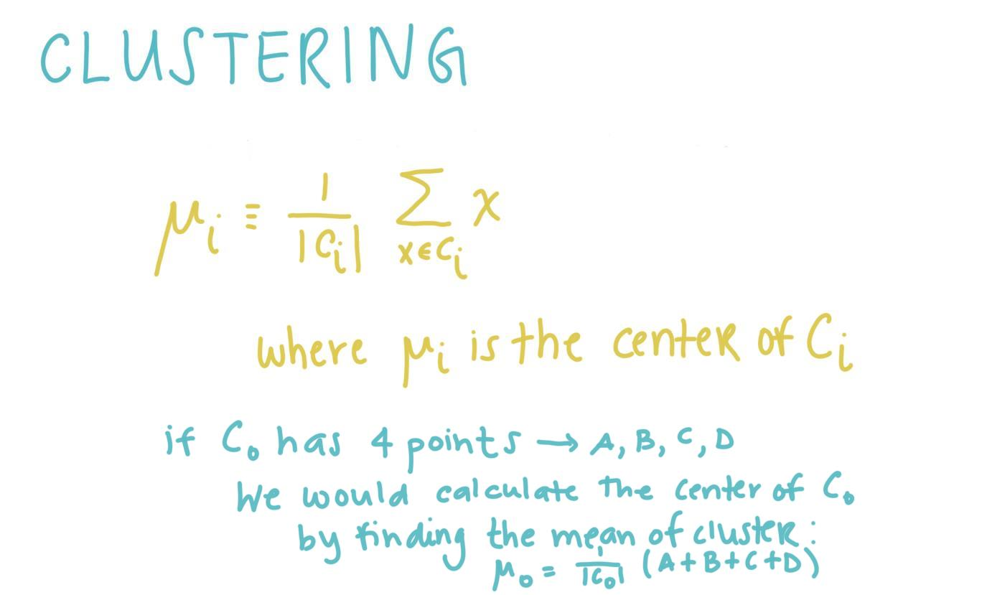
Notes:
Thus, for example, if C0 has 4 points in the cluster . A,B,C,D. We would calculate mu (the center ) by finding the mean of the cluster which would be mu 0.

Slide 14
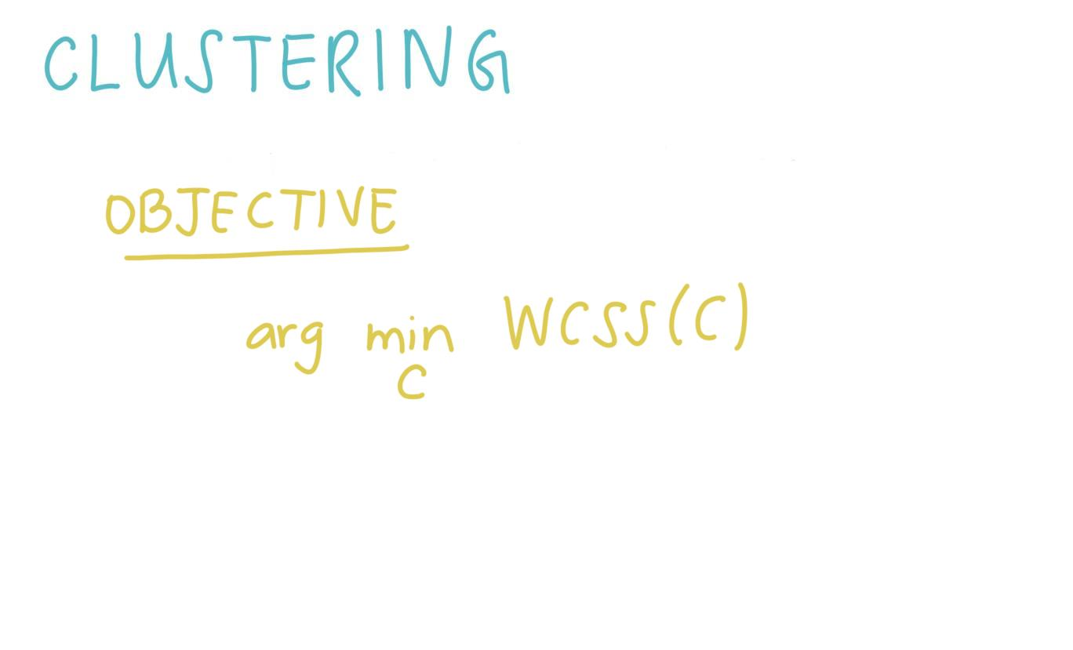
Notes:
Thus, our objective is to find the clustering of the dataset that minimizes the overall WCSS.

Slide 15
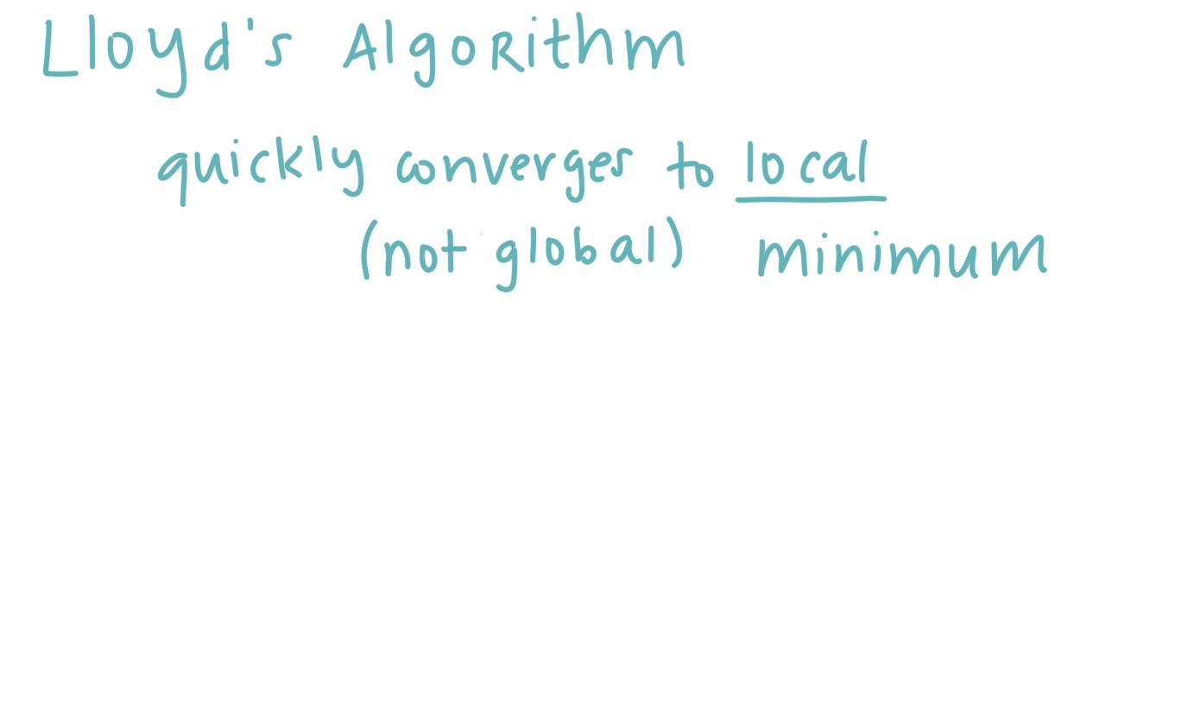
Notes:
There is an iterative method, known as Lloyd’s algorithm which can quickly converge to a local minimum.

Slide 16
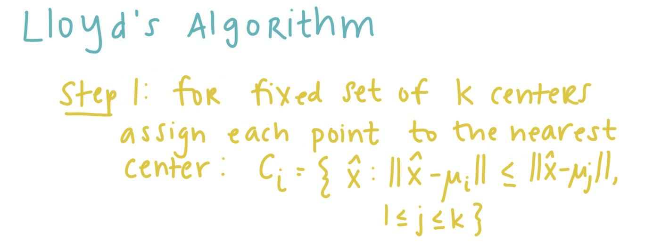
Notes:
Lloyd’s algorithm has two operations. The first is that given a fixed set of k centers, assign each point, x, to the nearest center.

Slide 17
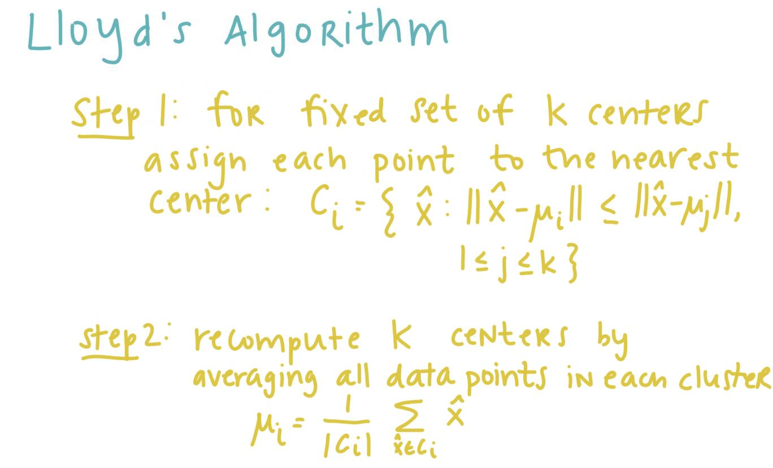
Notes:
The second operation is to recompute the k centers (also known as centroids) by averaging all the data points in each cluster, this is done by taking the mean.

Slide 18
Notes:
These 6 images visualize lloyd’s algorithm. In (a) we start with a dataset. In (b) we put our initial guess for our two centroids represented by the blue and red x . Now, using the first part of llody’s operation, in part c, the data points are assigned to the closest centroid. The centroid is then constantly recalculated and the points reassigned until convergence to a local minimum is reached in (f).

Slide 19
Notes:
Now that we understand how k-means works intuitively, we will see how to implement the algorithm in python. In the next few lessons, we will work together to create Lloyd’s algorithm.

